Slide 1
ACT Analysis (2017-2019)
Notes:
Adult Changes in Thought (ACT).
The ACT is mandatory in several states, which can lead to higher participation rates and a more comprehensive dataset for analysis.

Slide 2
ACT test situation in the US?
First Question: What is the current state of the ACT test in the U.S? The likelihood of taking it, overall, reflects the quality of the score.
Problem Statement
ACT participation rates vary a lot across different U.S. states. Some states require the test, while others don’t, and this affects both test scores and how students perform overall. Looking at these trends by year and region can help us understand the reasons for participation drops and how they might relate to college readiness. Comparing ACT participation with SAT rates could also give more insights and help improve participation in areas where it’s decreasing.
Notes:
Audience

Slide 3
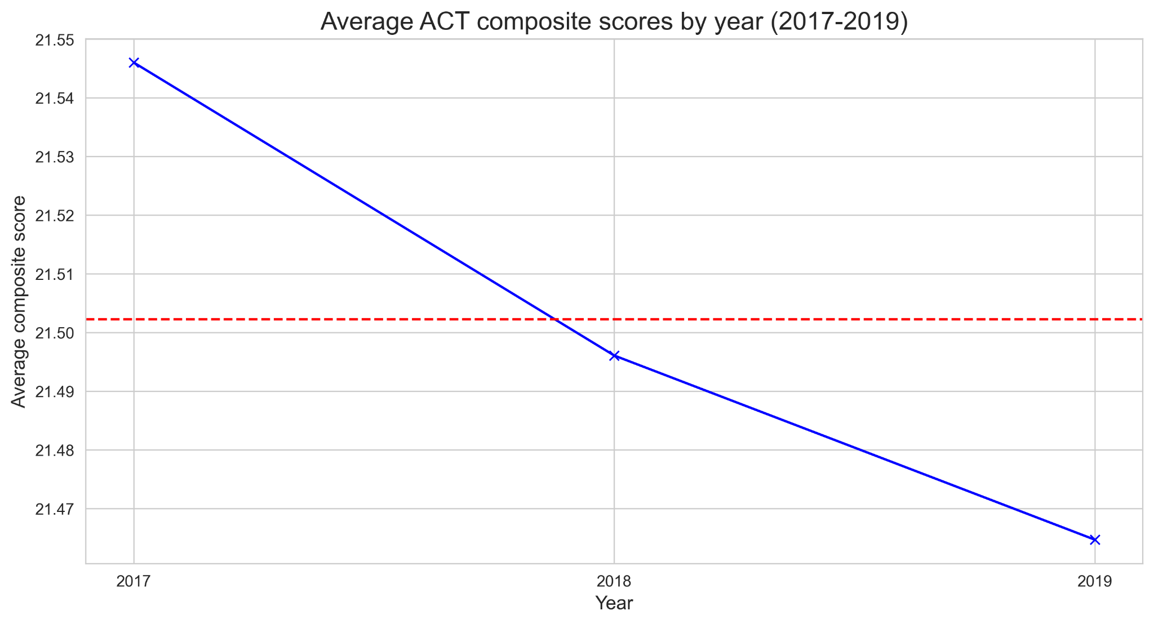
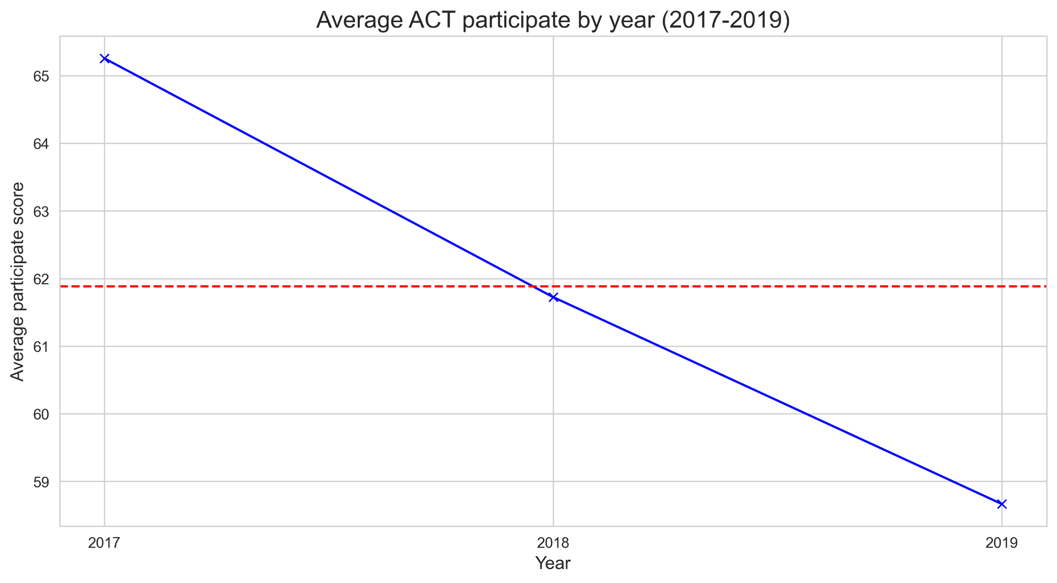
Average ACT composite/participation by year
Notes:
Did you see the trend on the graph it show the same way of decrease but the insight data show the negative relationship
The Y axis show the avg score that make you curious but when we zoom into the gap between the Y axis is not much we can the score is changed around .5 but Yes it still decrease In fact the
Mean ACT Composite scores will typically decrease by 1.22 score points for each additional 25% tested. ACT English scores are typically most sensitive to the effects of statewide adoption (https://www.act.org/content/dam/act/unsecured/documents/Statewide-Adoption.pdf)
The graphs aim to highlight trends in both metrics, and it’s important to interpret the data accurately. Further analysis is needed to understand the factors contributing to these changes and how significant they are in practical terms.

Slide 4
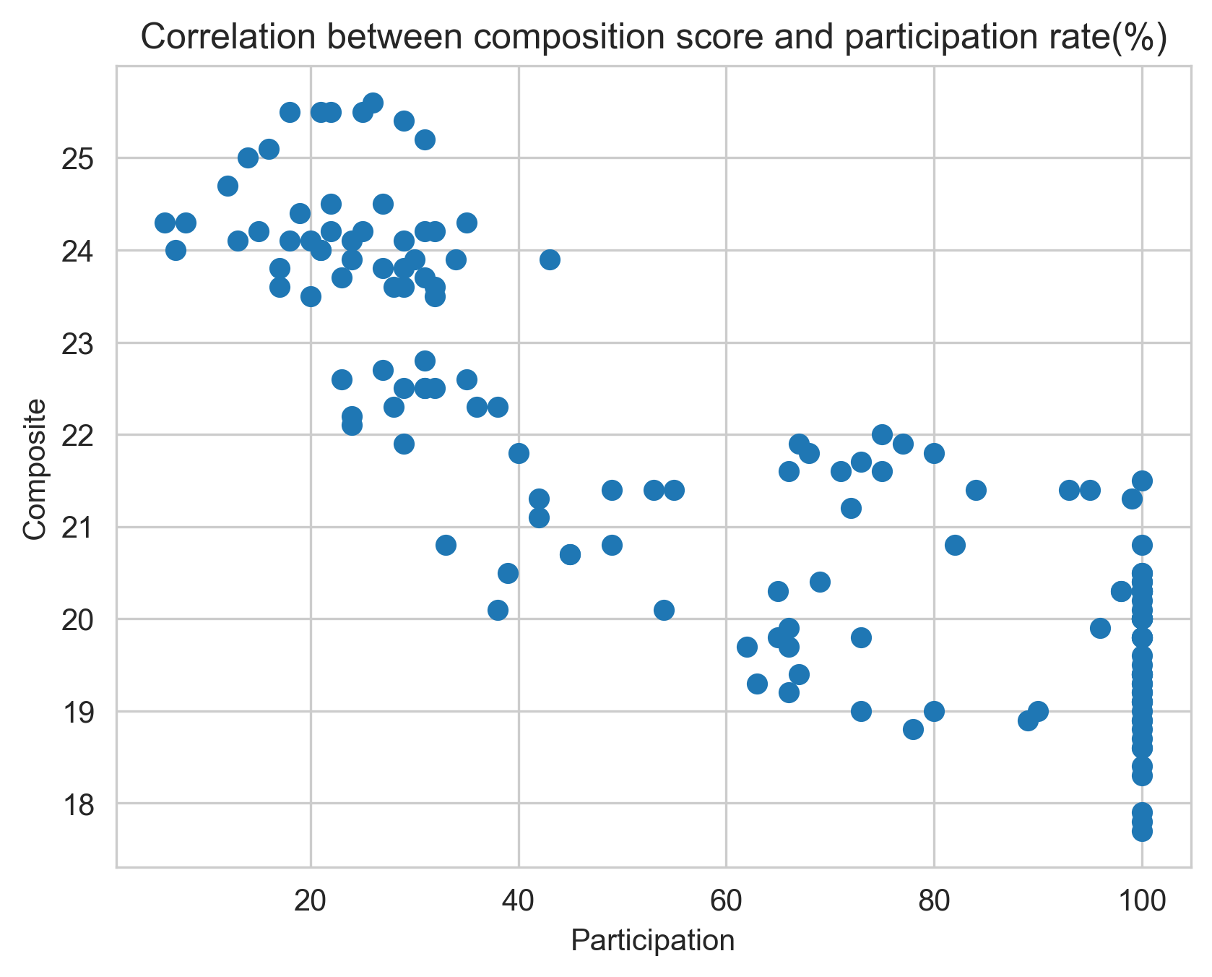
ACT correlation composite and participation
Notes:
-0.85
This is negative correlation This suggests that a wider range of academic abilities are represented when more students have to or pushed to take the ACT, which lowers the average composite score. On the other hand, if fewer students take the test in a state, those who do are probably more motivated or more prepared, which could lead to higher average scores.
This trend is important when interpreting ACT scores, as high participation rates don't necessarily correlate with high performance.

Slide 5
ACT participation and composite scores
High Participation, Lower Scores: The average composite score can be lower in states or years with higher rates of participation.
Low Participation, Higher Scores: On the other hand, states or years with lower rates of participation may have average composite scores that are higher.
Notes:
After we know the relationship between the composite score and participation , we are going to focus on the participation rate

Slide 6
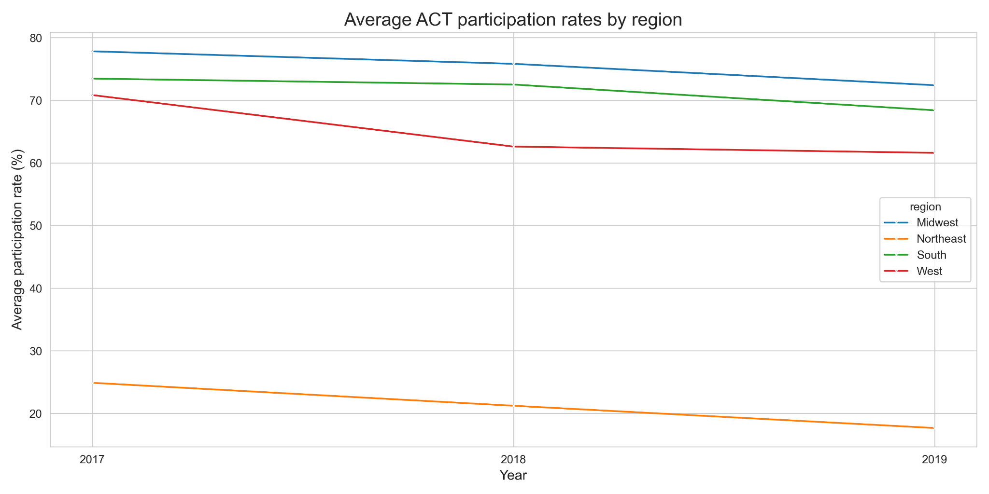
Average ACT participation rates by region
Notes:
Do you see the trend by region every participation rate still decrease
The sharp decline in participation is highlighted across regions like the Midwest and West. This visual can help demonstrate the trends over the years, especially the significant drop-off.

Slide 7
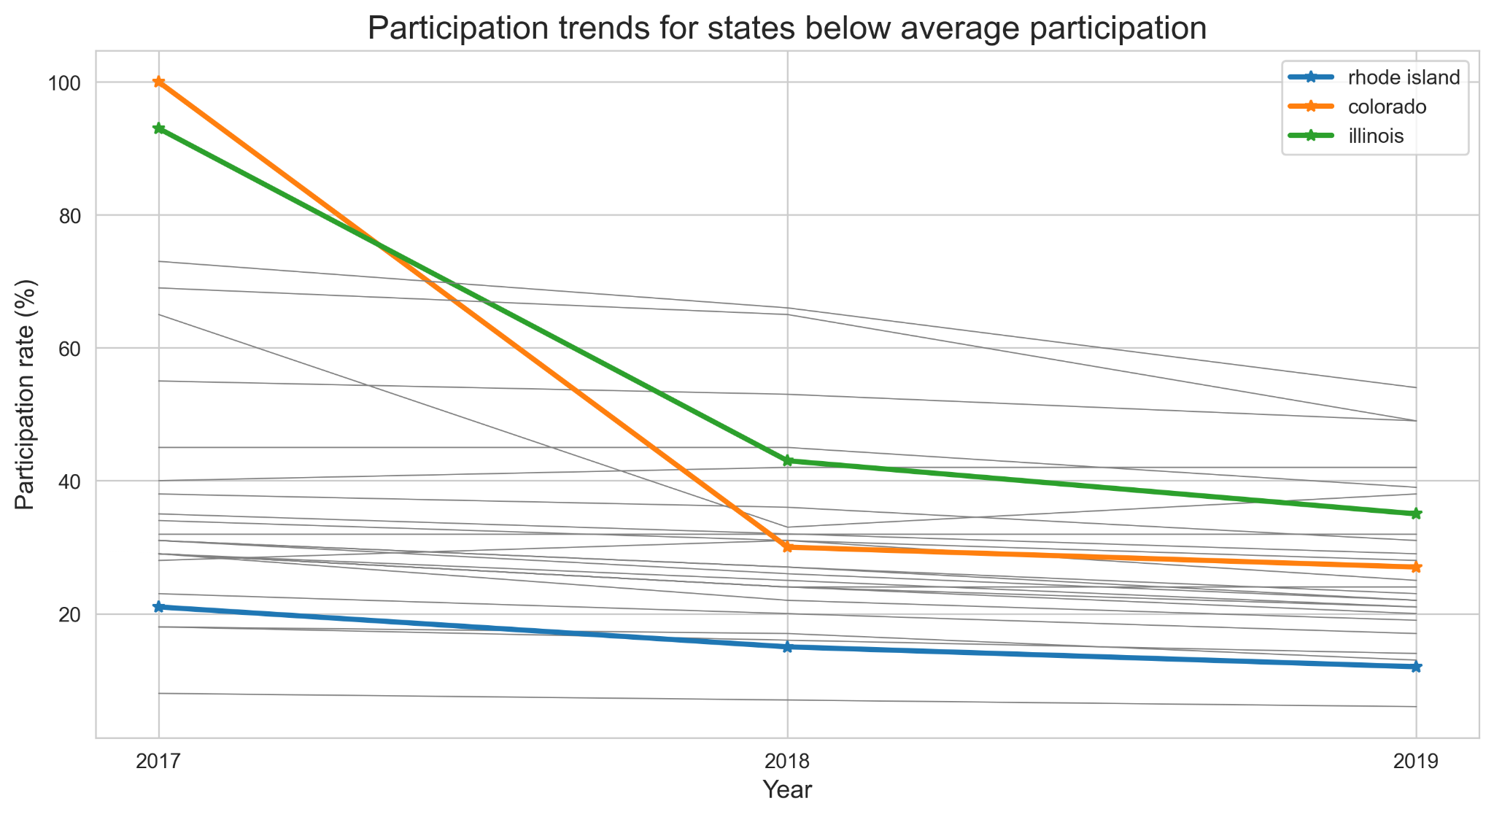
Significant decrease in participation rate
Colorado
Illinois
Rhode Island
Notes:
26 state show the decreasing but the data show 3 state have significate decrease that are Colorado , Illinois , rode island and Next will answer the question is it same region

Slide 8
Is it the same region?
State : Colorado
Region : West
State : Illinois
Region : Midwest
State : Rhode Island
Region : Northeast
Notes:
The answer is no it take more time to deep dive into the lake of data to find out in each state…We are going to comparison with direct competitor ‘SAT”

Slide 9
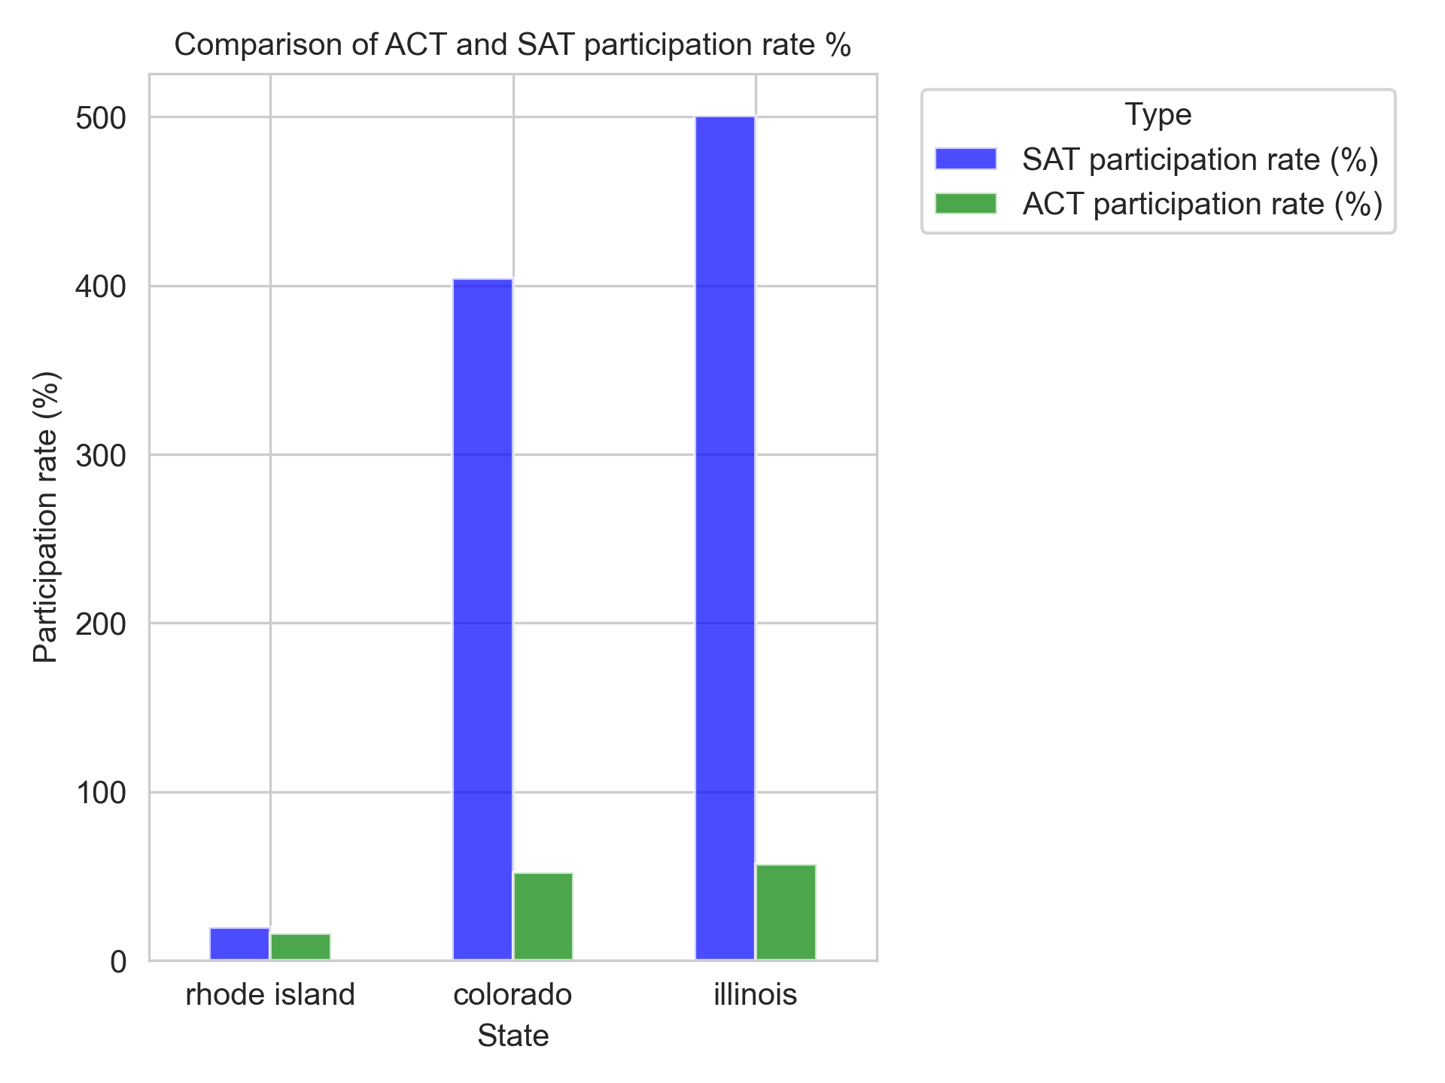
Comparison of ACT and SAT participation
Notes:
rhode island 19.856251 Colorado 404.545455 Illinois 500.505051 We are going to comparison with direct competitor ‘SAT”
Significant increase in participation rate of SAT in 2 states, but the data notices that the participation rate in rhode Island is less for 2 types of tests and we need to be concerned.

Slide 10
Next steps to gain further insight
Collect more information.
Colorado made the ACT mandatory for high school students starting in 2001. However, this changed in 2017 when Colorado switched to requiring the SAT, though the ACT remained available as an option.
Colorado’s Switch from ACT to SAT
Illinois finalizes decision to switch from ACT to SAT
Illinois Finalizes Decision to Switch From ACT to SAT
A deeper analysis is recommended to investigate the specific reasons behind declining participation rates in regions with historically high participation. This analysis should focus on how changes in educational policy, economic conditions, and test perceptions are shaping these trends. For example, one question to consider is: Why does accounting, a major that typically doesn't require advanced science knowledge, require a science score from the ACT?
Notes:
Colorado made the ACT mandatory for high school students starting in 2001. However, this changed in 2017 when Colorado switched to requiring the SAT, though the ACT remained available as an option.
In 2017 , Us had people move to Colorado with hope to have a better quality of life that make the dramatic change in the number of participation on SAT (extremely high)

Slide 11


